Slide 1
Managing Multiple Nodes

Slide 2
Another Web Node
Bootstrap a new node
Update the run list of the new node to include the web server cookbook
Login to that system and run chef-client
Verify that the node's web server is functional

Slide 3
$ knife bootstrap FQDN -x USER -P PASSWORD --sudo -N node3
Connecting to ec2-54-176-64-173.us-west-1.compute.amazonaws.com
ec2-54-176-64-173.us-west-1.compute.amazonaws.com Starting first Chef Client run...
ec2-54-176-64-173.us-west-1.compute.amazonaws.com Starting Chef Client, version 12.3.0
ec2-54-176-64-173.us-west-1.compute.amazonaws.com Creating a new client identity for node3 using the validator key.
ec2-54-176-64-173.us-west-1.compute.amazonaws.com resolving cookbooks for run list: []
ec2-54-176-64-173.us-west-1.compute.amazonaws.com Synchronizing Cookbooks:
ec2-54-176-64-173.us-west-1.compute.amazonaws.com Compiling Cookbooks...
ec2-54-176-64-173.us-west-1.compute.amazonaws.com [2015-05-15T22:45:40+00:00] WARN: Node node3 has an empty run list.
ec2-54-176-64-173.us-west-1.compute.amazonaws.com Converging 0 resources
ec2-54-176-64-173.us-west-1.compute.amazonaws.com
ec2-54-176-64-173.us-west-1.compute.amazonaws.com Running handlers:
ec2-54-176-64-173.us-west-1.compute.amazonaws.com Running handlers complete
ec2-54-176-64-173.us-west-1.compute.amazonaws.com Chef Client finished, 0/0 resources updated in 6.084107811 seconds

Slide 4
$ knife node show node3
Node Name: node3
Environment: _default
FQDN: ip-10-197-105-148.us-west-1.compute.internal
IP: 54.176.64.173
Run List:
Roles:
Recipes:
Platform: ubuntu 14.04
Tags:

Slide 5
$ knife node run_list add node3 "recipe[apache]"
node3:
run_list: recipe[apache]

Slide 6
$ knife ssh "*:*" -x USERNAME -P PASSWORD "sudo chef-client"
ec2-50-18-19-208.us-west-1.compute.amazonaws.com Starting Chef Client, version 12.3.0
ec2-204-236-155-223.us-west-1.compute.amazonaws.com Starting Chef Client, version 12.3.0
ec2-50-18-19-208.us-west-1.compute.amazonaws.com resolving cookbooks for run list: ["myhaproxy"]
ec2-204-236-155-223.us-west-1.compute.amazonaws.com resolving cookbooks for run list: ["apache"]
ec2-50-18-19-208.us-west-1.compute.amazonaws.com Synchronizing Cookbooks:
ec2-204-236-155-223.us-west-1.compute.amazonaws.com Synchronizing Cookbooks:
ec2-204-236-155-223.us-west-1.compute.amazonaws.com - apache
ec2-204-236-155-223.us-west-1.compute.amazonaws.com Compiling Cookbooks...
ec2-204-236-155-223.us-west-1.compute.amazonaws.com Converging 4 resources
ec2-204-236-155-223.us-west-1.compute.amazonaws.com Recipe: apache::server
ec2-50-18-19-208.us-west-1.compute.amazonaws.com - build-essential
ec2-50-18-19-208.us-west-1.compute.amazonaws.com - cpu
ec2-50-18-19-208.us-west-1.compute.amazonaws.com - myhaproxy
ec2-50-18-19-208.us-west-1.compute.amazonaws.com - haproxy
ec2-50-18-19-208.us-west-1.compute.amazonaws.com Compiling Cookbooks...

Slide 7
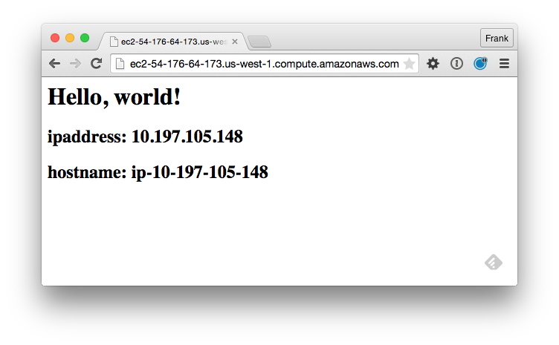

Slide 8
Update the Proxy
Update the wrapped proxy server cookbook to include the new web node as a member.
Upload that cookbook to the Chef Server
Login to that system and run chef-client
Verify that the proxy server delivers traffic to both web server nodes.

Slide 9
chef-repo/cookbooks/myhaproxy/recipes/default.rb
node.default['haproxy']['members'] = [{
"hostname" => "ec2-204-236-155-223.us-west-1.compute.amazonaws.com",
"ipaddress" => "ec2-204-236-155-223.us-west-1.compute.amazonaws.com",
"port" => 80,
"ssl_port" => 80
},{
"hostname" => "ec2-54-176-64-173.us-west-1.compute.amazonaws.com",
"ipaddress" => "ec2-54-176-64-173.us-west-1.compute.amazonaws.com",
"port" => 80,
"ssl_port" => 80
}
]
include_recipe "haproxy::default"

Slide 10
chef-repo/cookbooks/myhaproxy/metadata.rb
name 'myhaproxy'
maintainer 'The Authors'
maintainer_email 'you@example.com'
license 'all_rights'
description 'Installs/Configures myhaproxy'
long_description 'Installs/Configures myhaproxy'
version '0.2.0'
depends 'haproxy', '~> 1.6.6'

Slide 11
$ cd ~/chef-repo/cookbooks/myhaproxy

Slide 12
$ berks install
Resolving cookbook dependencies...
Fetching 'myhaproxy' from source at .
Fetching cookbook index from https://supermarket.chef.io...
Using build-essential (2.2.3)
Using cpu (0.2.0)
Using haproxy (1.6.6)
Using myhaproxy (0.2.0) from source at .

Slide 13
$ berks upload
Skipping build-essential (2.2.3) (frozen)
Skipping cpu (0.2.0) (frozen)
Skipping haproxy (1.6.6) (frozen)
Uploaded myhaproxy (0.2.0) to: 'https://api.opscode.com:443/organizations/vogue'

Slide 14
$ knife ssh "*:*" -x USERNAME -P PASSWORD "sudo chef-client"
ec2-50-18-19-208.us-west-1.compute.amazonaws.com Starting Chef Client, version 12.3.0
ec2-204-236-155-223.us-west-1.compute.amazonaws.com Starting Chef Client, version 12.3.0
ec2-50-18-19-208.us-west-1.compute.amazonaws.com resolving cookbooks for run list: ["myhaproxy"]
ec2-204-236-155-223.us-west-1.compute.amazonaws.com resolving cookbooks for run list: ["apache"]
ec2-50-18-19-208.us-west-1.compute.amazonaws.com Synchronizing Cookbooks:
ec2-204-236-155-223.us-west-1.compute.amazonaws.com Synchronizing Cookbooks:
ec2-204-236-155-223.us-west-1.compute.amazonaws.com - apache
ec2-204-236-155-223.us-west-1.compute.amazonaws.com Compiling Cookbooks...
ec2-204-236-155-223.us-west-1.compute.amazonaws.com Converging 4 resources
ec2-204-236-155-223.us-west-1.compute.amazonaws.com Recipe: apache::server
ec2-50-18-19-208.us-west-1.compute.amazonaws.com - build-essential
ec2-50-18-19-208.us-west-1.compute.amazonaws.com - cpu
ec2-50-18-19-208.us-west-1.compute.amazonaws.com - myhaproxy
ec2-50-18-19-208.us-west-1.compute.amazonaws.com - haproxy
ec2-50-18-19-208.us-west-1.compute.amazonaws.com Compiling Cookbooks...

Slide 15
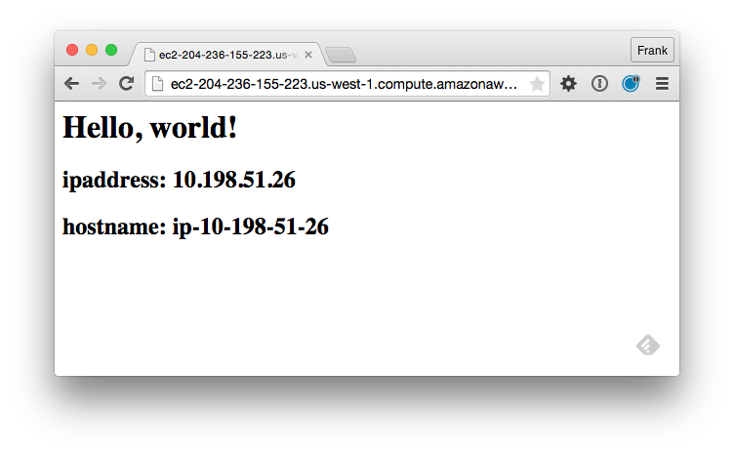


Slide 16


Slide 17
Discussion
What questions can we help you answer?

